Slide 1





Regular Expressions (RegEx)
Advanced Text Manipulation
SoftUni Team
Technical Trainers
Software University
http://softuni.bg

Slide 2

Table of Contents
Regular Expressions
What are Regular Expressions?
Characters
Operators
Constructs
Regular Expressions in C#

Slide 3
Questions
sli.do #tech-softuni

Slide 4
Regular Expressions
Groups, Quantifiers, Anchors

Slide 5
Regular Expressions
Describe a search pattern
Can be used to extract data from text
[A-Z][a-z]+ [A-Z][a-z]+ - \w+@\w+\.\w+
matches
Ivan Ivanov – ivan@gmail.com
Petar Iotov – petar@abv.bg
Contact: Alex Georgiev – alex@mail.com...

Slide 6
Character Classes
[nvj] matches any character that is either n, v or j
[^abc] – matches any character that is not a, b or c
[0-9] - Character range: Мatches any digit frm 0 to 9
node.js v0.12.2
Abraham Lincoln
In 1519 Leonardo da Vinci died at the age of 67.

Slide 7
Character Classes (2)
\w – Matches any word character (a-z, A-Z, 0-9, _)
\W – Matches any non-word character (the opposite of \w)
\s – Matches any white-space character
\S – Matches any non-white-space character (opposite of \s)
\d – Matches any decimal digit
\D – Matches any non-decimal digit (opposite of \d)
aBcd 09_ &*^ Ю-Я
aBcd 09_ &*^ Ю-Я
Notes:
\w – Matches any word character (a-z, A-Z, 0-9, _)
\W – Matches any non-word character (the opposite of \w)
\s – Matches any white-space character
\S – Matches any non-white-space character (opposite of \s)
\d – Matches any decimal digit
\D – Matches any non-digit character (opposite of \d)

Slide 8
Quantifiers
* - Matches the previous element zero or more times
+ - Matches the previous element one or more times
? - Matches the previous element zero or one time
+359885976002
+
\+\d*
=>
+359885976002
+
\+\d+
=>
\+\d?
=>
+359885976002
+

Slide 9
Character Escapes
Sometimes you will need to look for special characters like new lines or tabulations
This is a “tab”
Then we have a new line
Name: Peter
Phone: +359882042353
We can use character escapes in our RegEx like that:
Name:\t\w+\nPhone:\s*\+\d+

Slide 10

Anchors
^ - The match must start at the beginning of the string or line
$ - The match must occur at the end of the string
Example – username validation pattern:
Note: Test one by one, $ asserts string end
^\w{6,12}$
jeff_butt
short
johnny
too_long_username
!lleg@l_ch@rs

Slide 11

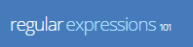
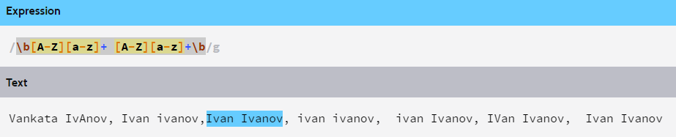
Problem: Match full name
You are given a sequence of words
Find those who are full names
You can use RegXr or Regex101

Slide 12
Grouping Constructs
(subexpression) - captures the matched subexpression and assigns it a number
(?:subexpression) – Defines a non-capturing group
\d{2}-(\w{3})-\d{4}
=>
22-Jan-2015
^(?:Hi|hello),\s*(\w+)$
=>
Hi, Peter

Slide 13
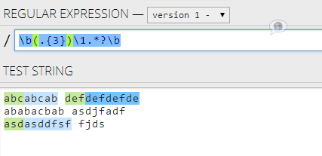
Backreference Constructs

Slide 14
Backreference Constructs
\number – matches the value of a numbered subexpression
\k<name> – matches the value of a named expression
22-12-2015
05/08/2016
\d{2}(-|\/)\d{2}\1\d{4}
=>
22-12-2015
05/08/2016
\d{2}(?<del>-|\/)\d{2}\k<del>\d{4}
=>

Slide 15

Playing with RegEx
Exercises in class

Slide 16
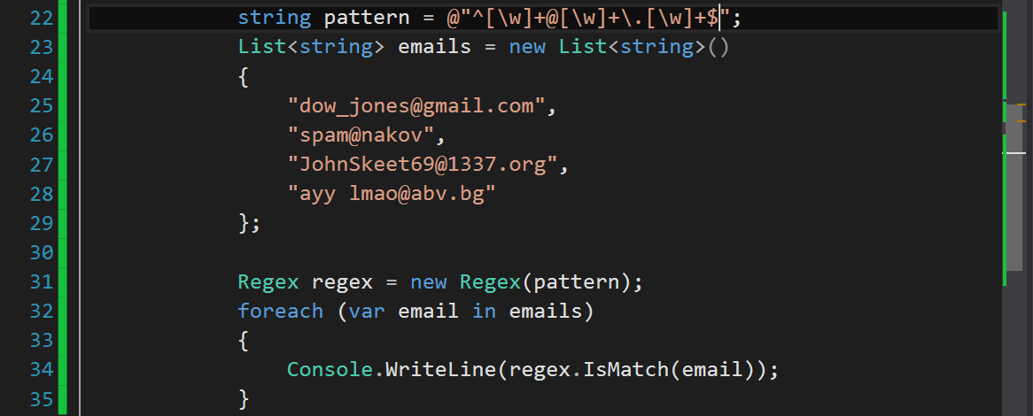
Regular Expressions
Using Built-In Regex Classes

Slide 17
Regex
C# supports a built-in regular expression class - Regex
Located in System.Text.RegularExpressions namespace
string pattern = @"A\w+";
Regex regex = new Regex(pattern);

Slide 18
Validating String By Pattern
IsMatch(string text) – determines whether the text matches the pattern
string text = "Today is 2015-05-11";
string pattern = @"\d{4}-\d{2}-\d{2}";
Regex regex = new Regex(pattern);
bool containsValidDate = regex.IsMatch(text);
Console.WriteLine(containsValidDate); // True

Slide 19
Checking for a Single Match
Match(string text) – returns the first match that corresponds to the pattern
string text = "Nakov: 123";
string pattern = @"([A-Z][a-z]+): (\d+)";
Regex regex = new Regex(pattern);
Match match = regex.Match(text);
Console.WriteLine(match.Groups.Count); // 3
Console.WriteLine("Matched text: \"{0}\"", match.Groups[0]);
Console.WriteLine("Name: {0}", match.Groups[1]); // Nakov
Console.WriteLine("Number: {0}", match.Groups[2]); // 123

Slide 20
Checking for Matches
Matches(string text) – returns a collection of matching strings that correspond to the pattern
string text = "Nakov: 123, Branson: 456";
string pattern = @"([A-Z][a-z]+): (\d+)";
Regex regex = new Regex(pattern);
MatchCollection matches = regex.Matches(text, pattern);
Console.WriteLine("Found {0} matches", matches.Count);
foreach (Match match in matches)
{
Console.WriteLine("Name: {0}", match.Groups[1]);
}
// Found 2 matches
// Name: Nakov
// Name: Branson

Slide 21
Replacing With Regex
Replace(string text, string replacement) – replaces all strings that match the pattern with the provided replacement
string text = "Nakov: 123, Branson: 456";
string pattern = @"\d{3}";
string replacement = "999";
Regex regex = new Regex(pattern);
string result = regex.Replace(text, replacement);
Console.WriteLine(result);
// Nakov: 999, Branson: 999

Slide 22
Problem: Replace <a> tag
You are given a html text.
Replace all <a> tags in it with [URL].
<ul> <li> <a href="http://softuni.bg">SoftUni</a>
</li> </ul>
<ul> <li> [URL href="http://softuni.bg"]SoftUni[/URL]
</li></ul>
Check your solution here: https://judge.softuni.bg/Contests/Practice/Index/320#7

Slide 23
Solution: Replace <a> tag
string text = Console.ReadLine();
while (text != "end")
{
string pattern =
@"<a.*?href.*?=(.*)>(.*?)<\/a>";
string replace = @"[URL href=$1]$2[/URL]";
string replaced = Regex.Replace(text, pattern,
replace);
Console.WriteLine(replaced);
text = Console.ReadLine();
}
Notes:
You can try also: @"<a.*href=((?:.|\n)*?(?=>))>((?:.|\n)*?(?=<))<\/a>"

Slide 24
Splitting With Regex
Split(string text) – splits the text by the pattern
Returns string[]
string text = "1 2 3 4";
string pattern = @"\s+";
string[] results = Regex.Split(text, pattern);
Console.WriteLine(string.Join(", ", results)); // 1, 2, 3, 4

Slide 25
Built-in RegEx
Exercises in class

Slide 26

Summary
Strings are immutable sequences of
characters
Changes to the string create a new object,
instead of modifying the old one
StringBuilder offers good performance
Regular expressions describe patterns for
searching through text
Define special characters, operators and
constructs for building complex patterns

Slide 27









Regular Expressions (RegEx)
https://softuni.bg/courses/programming-fundamentals

Slide 28

License
This course (slides, examples, demos, videos, homework, etc.) is licensed under the "Creative Commons Attribution-NonCommercial-ShareAlike 4.0 International" license
Attribution: this work may contain portions from
"Fundamentals of Computer Programming with C#" book by Svetlin Nakov & Co. under CC-BY-SA license
"C# Part I" course by Telerik Academy under CC-BY-NC-SA license
"C# Part II" course by Telerik Academy under CC-BY-NC-SA license

Slide 29




Trainings @ Software University
Software University Foundation – softuni.org
Software University – High-Quality Education, Profession and Job for Software Developers
softuni.bg
Software University @ Facebook
facebook.com/SoftwareUniversity
Software University Forums – forum.softuni.bg

